Slide 1
AME20216 - Lab I L10 – Semiconductor Devices

Slide 2
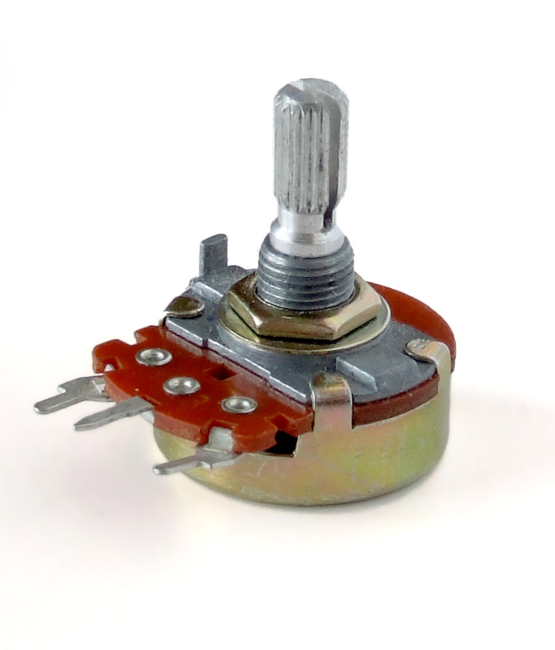
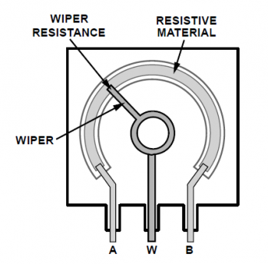
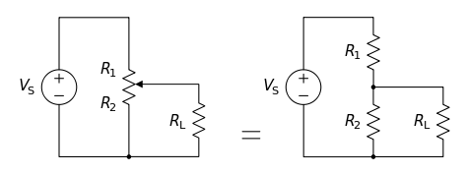
Potentiometers
Potentiometers convert angle into a resistance.
Works like a voltage divider!

Slide 3
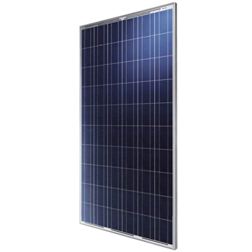
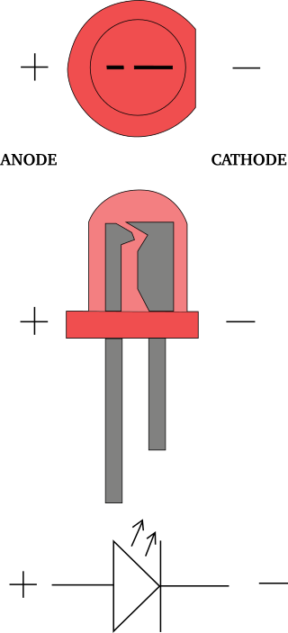
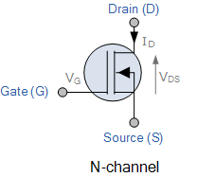
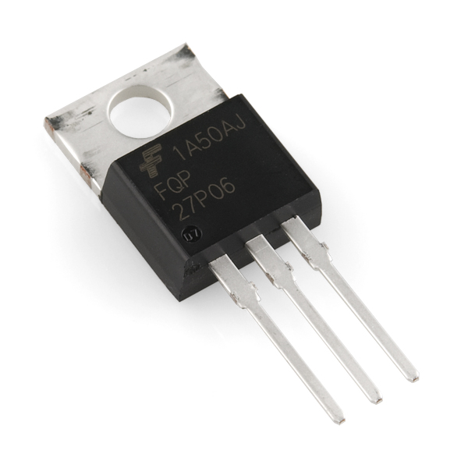
Semiconductor Devices
Solar Panels
Diodes and LEDs
Transistors

Slide 4
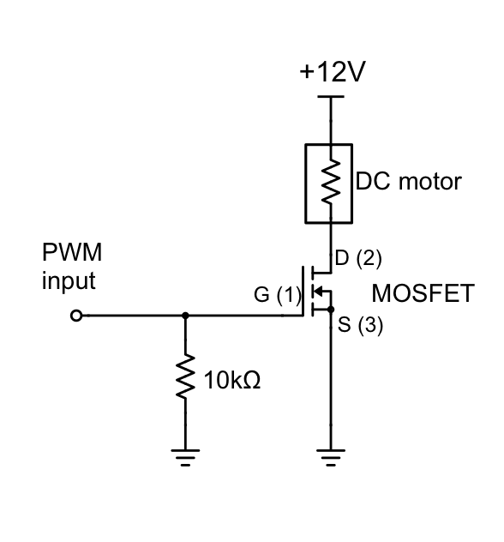
Transistors
Commonly used to drive motors

Slide 5
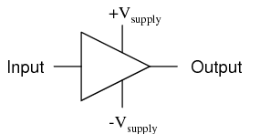
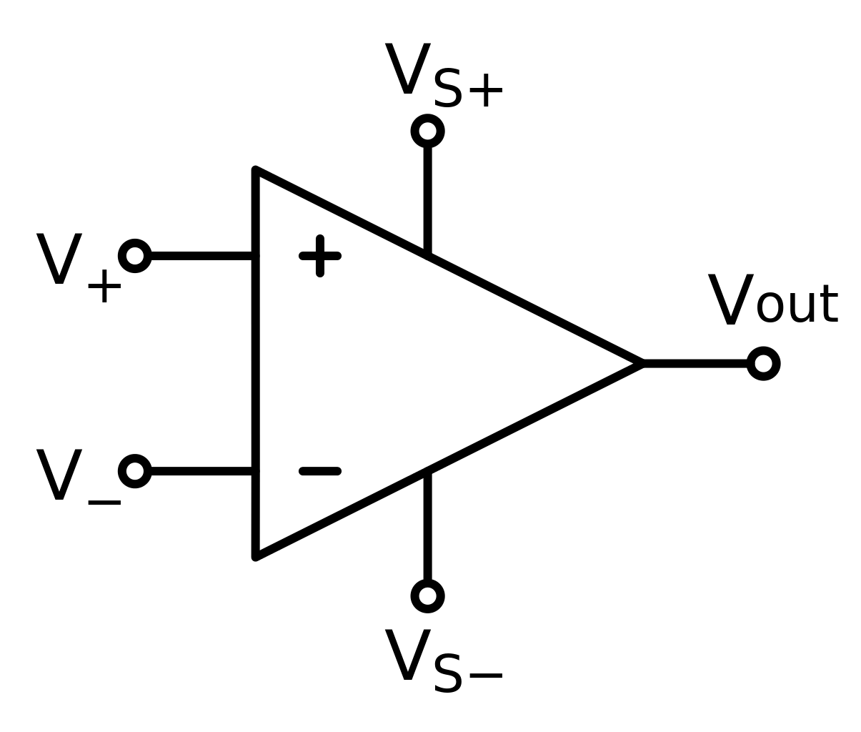
Amplifiers
Used to increase the signal-to-noise-ratio (SNR).
Differential Amplifier cancels out the “common” noise, only amplifies signal.

Slide 6
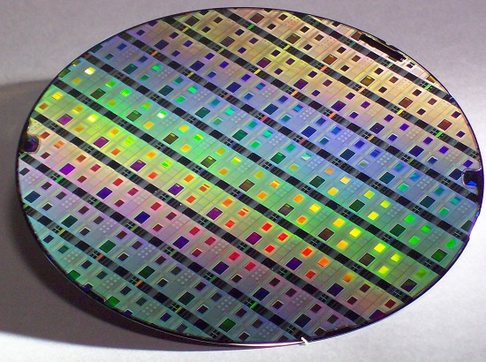
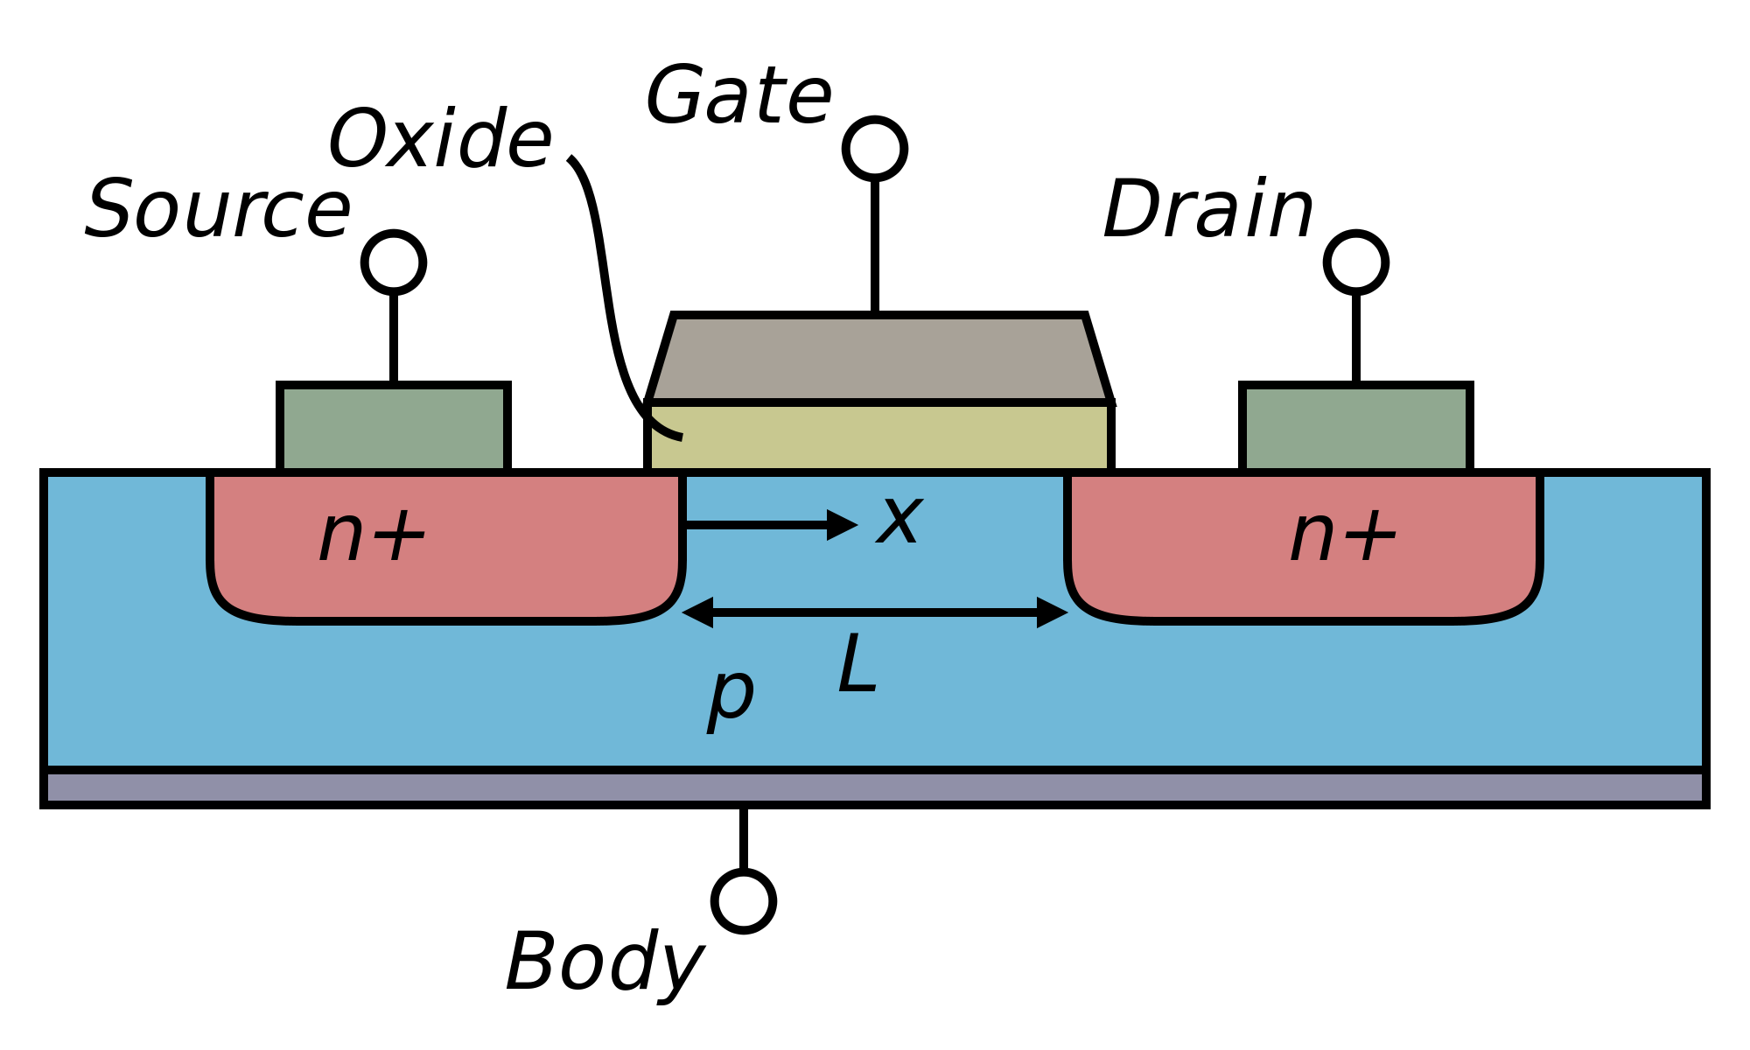
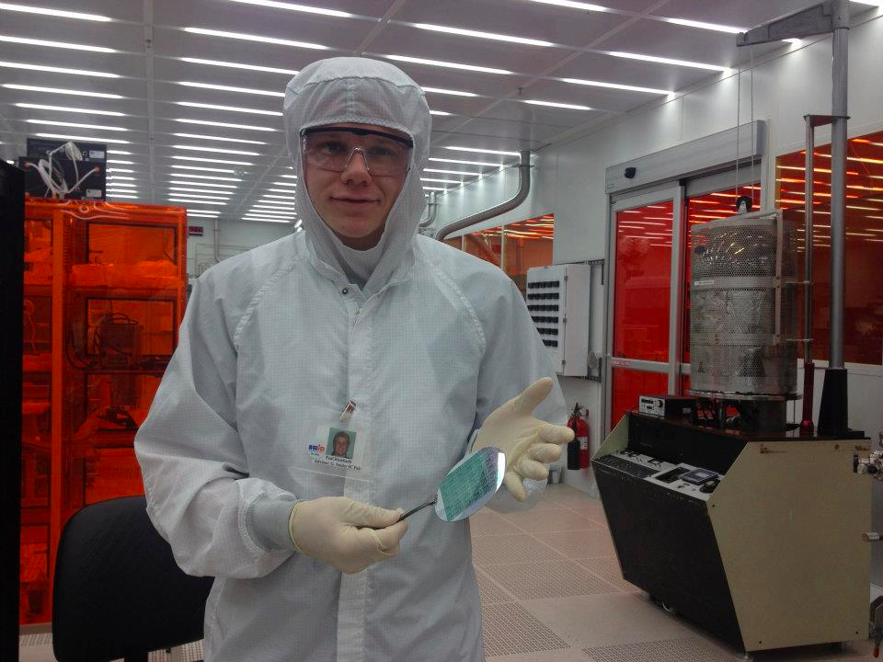

Integrated Circuits (I.C.s)
Solid state transistors can be fabricated en masse on a silicon substrate!
https://en.wikipedia.org/wiki/MOSFET

Slide 7
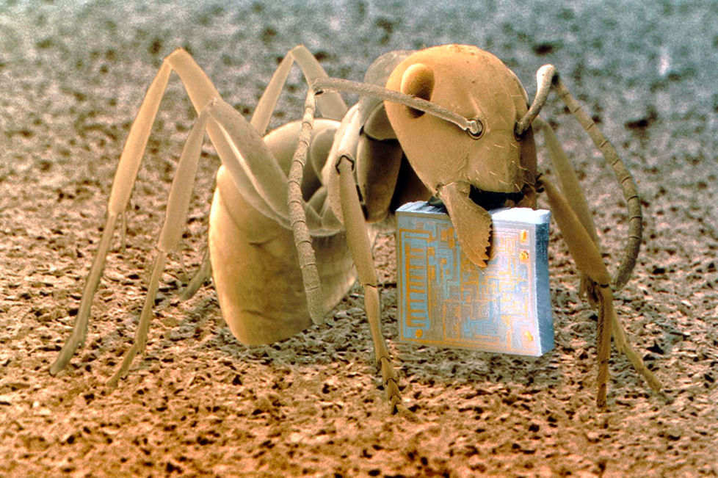
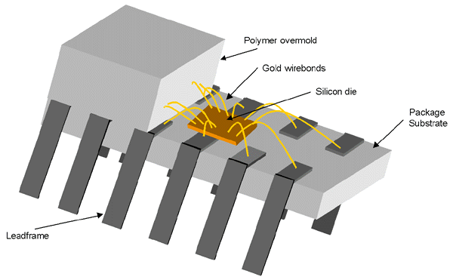
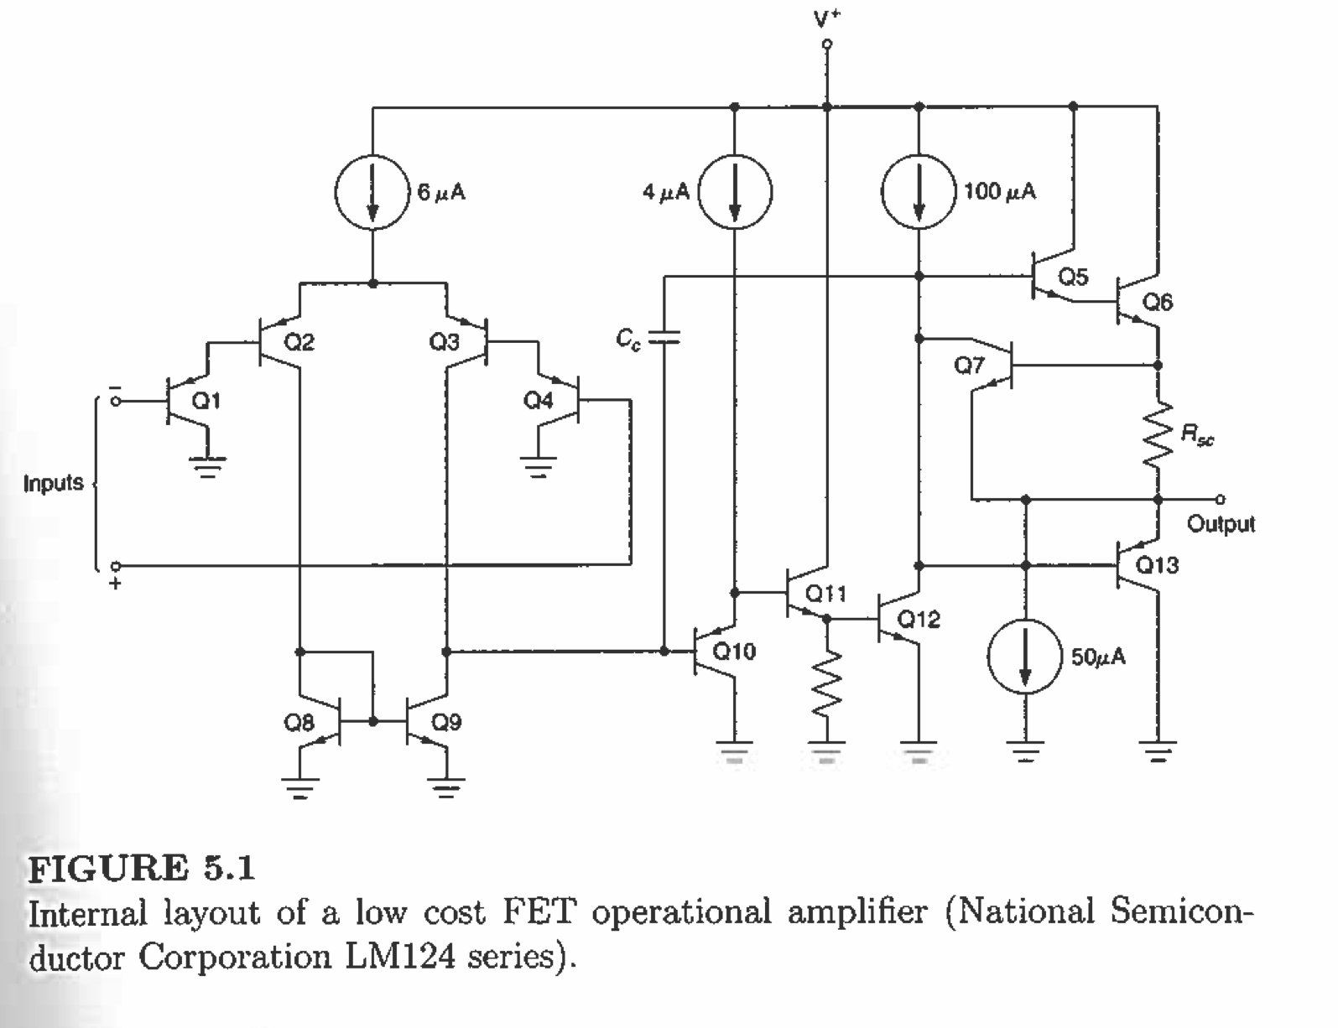
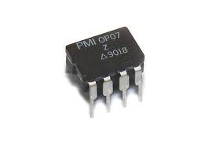
Integrated Circuits (I.C.s)
Wafers are diced up and packaged as IC chips.
DIP – “Dual inline package”

Slide 8
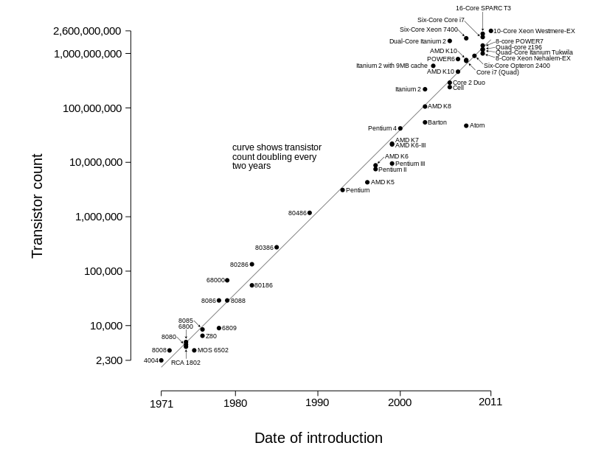
Moore’s Law
We can print over 1 billion transistors on a single chip!

Slide 9
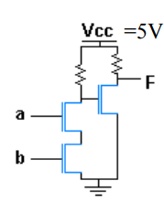
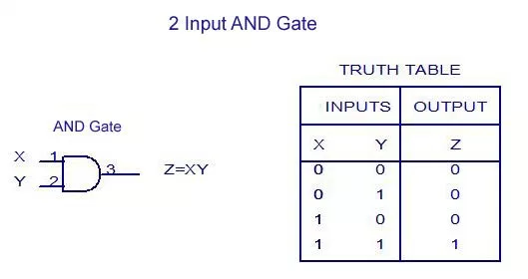
Logic Circuits
AND gate
Z
X
Y

Slide 10
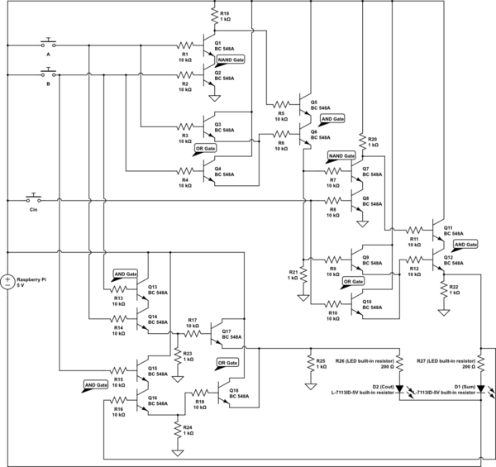
Logic Circuits – 2 bit adder

Slide 11
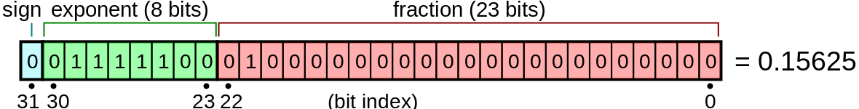
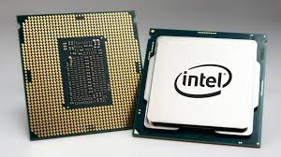
Analog vs. Digital
Digital – A single number is represented by many voltages that form a “binary code”
Analog – A single number is represented by a single voltage.

Slide 12
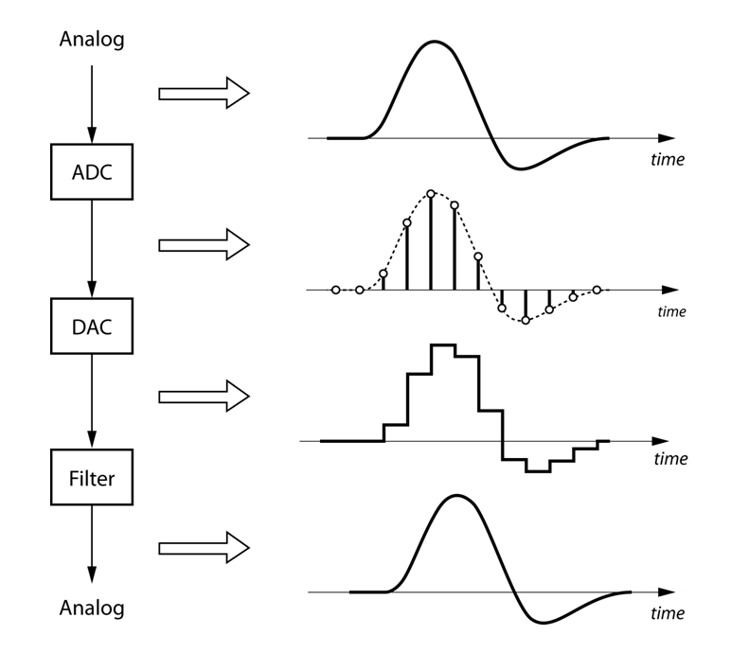
Analog-to-Digital Converter
A/D – analog to digital converter (i.e. LabQuest)
Continuous Analog
Discrete Digital
https://nutaq.com
D/A – digital to analog converter (i.e. an iPod)
Discrete Digital
“Continuous” Analog

Slide 13
Arduino Microcontroller
Microcontroller – A rudimentary computer that has several analog-to-digital converters, digital inputs, and digital outputs

Slide 14
A8 – Microcontroller + Thermistors
Microcontroller will read V_{out}, then calculate temperature.

